Slide 1
Online Examination System
Idea was to make a website in which user(Students) can take a quiz and analysis their result. Also, User(Teacher) can make a Quiz and Share with others.

Slide 2
Purpose And Scope
It is website for people who want to practice and improve their knowledge of specific subject.
It is easy way to evaluate and analysis your knowledge.
Also, you can compare your knowledge with other people and can contact persons who are creating the quiz to get some tips.
User will get Quiz with different type of difficulty.
This kind of website can use for university or for mock test ,too.
It is supporting all kind of question like True/False, Multiple Correct Choice, Filling the blank and standard MCQ.

Slide 3
Type Of User
Teacher : It can create quiz and modified their existing quiz.
Premium User: They can take specific quiz as many times they want from any category. They can contact quiz creator for advice. They can give rating and feedback to user. They can analysis their old score. They can see average score and maximum score of particular quiz. They can see no of attempt they have taken for particular quiz.
Normal User: They just can see all the quiz and take any quiz from categories only once.

Slide 4
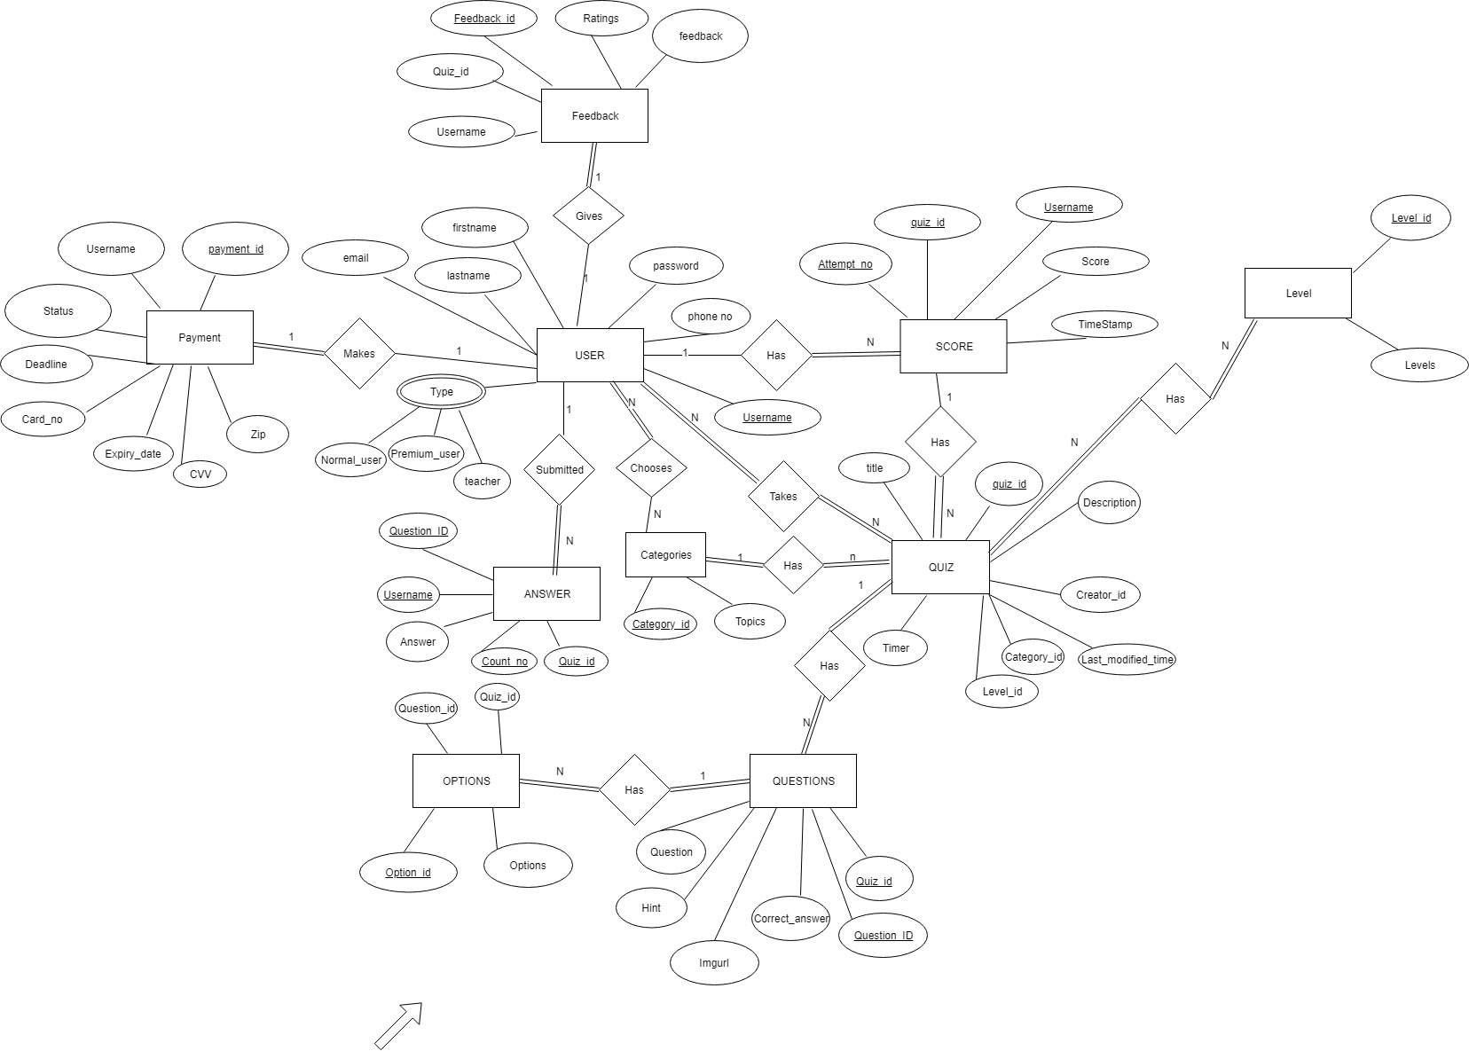
E-R Diagram

Slide 5

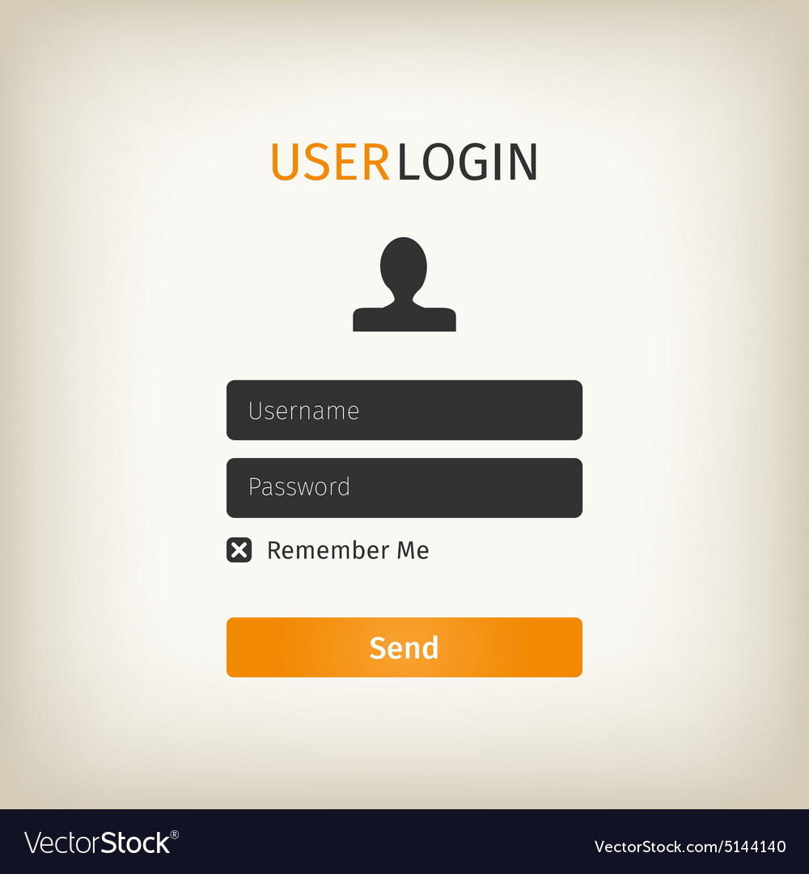
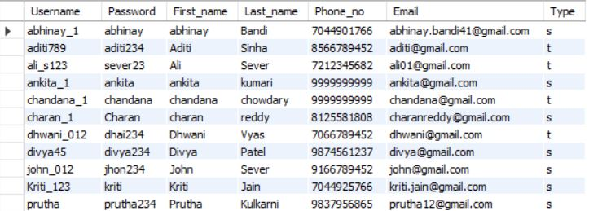

Log In Page
It will be simple log in page for user to log in like you can see in the image. After user will add log in information, it will see in database and try to find user type. If it is student type then it will check is it premium or normal using stored procedure ‘find_user_type’

Slide 6
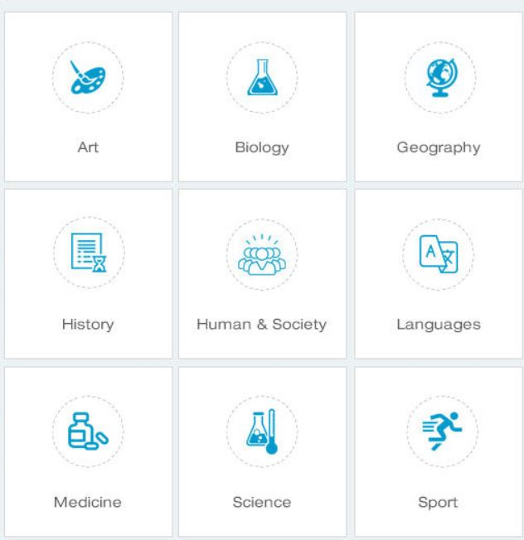
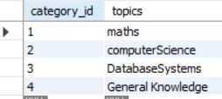
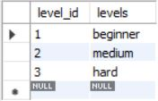
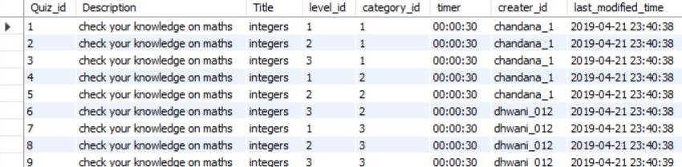
Categories And Quiz Page
If user is premium user or normal user then first will it show all categories from categories table. Also, it will have Score history and payment option in navigation bar.
If user will click particular category then it will show all the quiz related to it from Quiz table and if user is premium then it will show level of quiz ,timer, his max score, that quiz’s max score and average score. Also, it will show number of times that user has taken that quiz. For all this we have made stored procedure like ‘find_average_max_score’,’ find_user_max_score’.

Slide 7
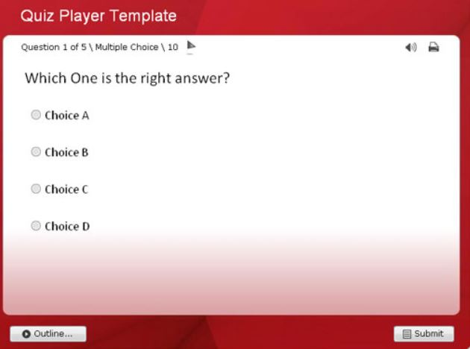
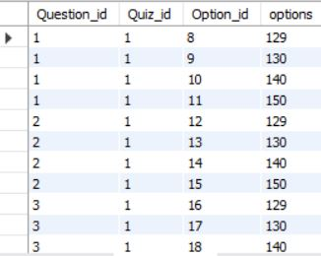
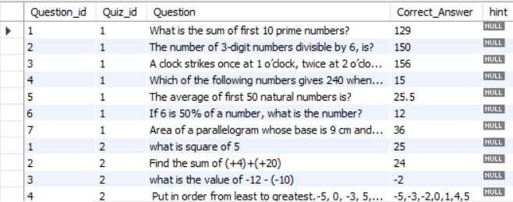
Quiz Page
When, User select any quiz from particular category it will start that quiz with that timer and display all the Question of that quiz from Question table and also all the Option from Option table. It will show hint also if creator have given one.

Slide 8
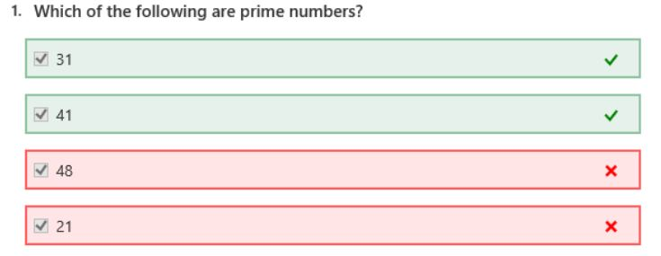

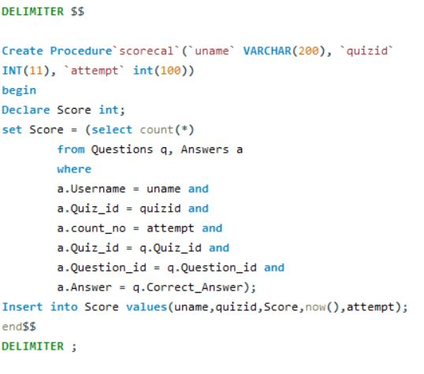
Whenever, user submit the quiz answers. It will all add in Answers table. When something will be added in answer table, using trigger ‘scorecal’ stored process will be call and it will calculate score and insert that score in score table. It will also note down attempt number and timestamp. We will show user the score and analysis of his quiz.
Score

Slide 9
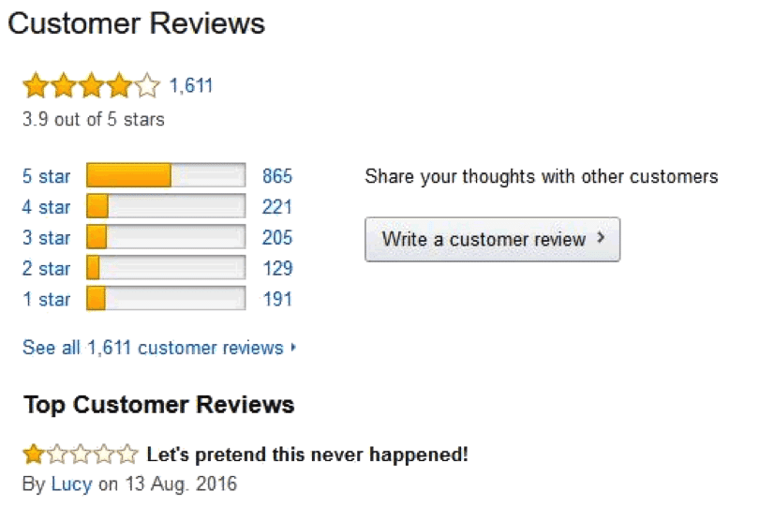

Feedback
User can give feedback and rating to Quiz. Also, he can update his old feedback. This information will be inserted to feedback table to store this evaluation.

Slide 10
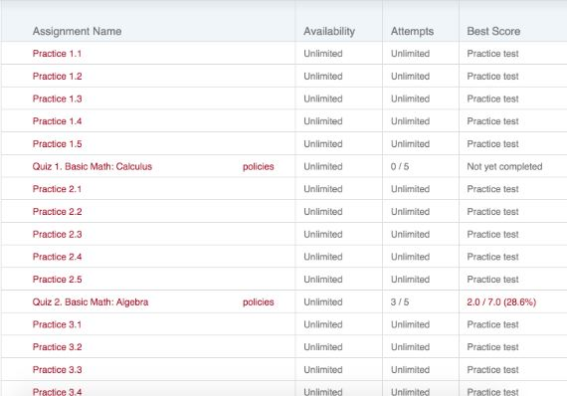
Teacher(User) Log in
When teacher type user will log in, first page will have all the category which are created by that user and last modified date of that quiz. Also, it will have option of create a new test, if user wants ,too.

Slide 11

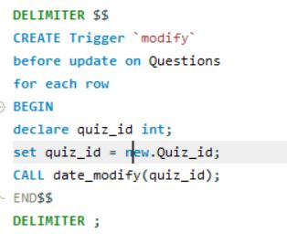
Quiz Page for Teacher
When teacher will click on particular quiz then it will show button to add questions, see the average score of student users, maximum score achieved by specific user, feedback of that quiz, no of user who have taken this quiz and at last the option to delete the quiz.
If teacher will modify something in particular quiz then Quiz table’s modified time column will get updated without doing anything in backend by trigger ’modify’.

Slide 12
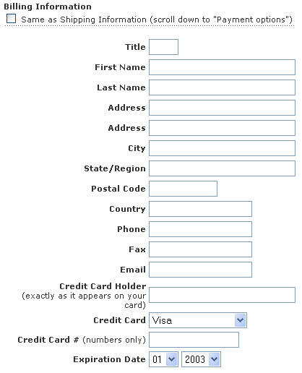
Create Quiz
When teacher type quiz want to create new quiz then , we will ask user to fill form which will include to fill category, Quiz title , description, level , questions and their options, correct answer, hints etc. When user submit the form after filling all the mandatory information, our Quiz, Questions tables will get updated and new information will be updated.

Slide 13
Thank You !!!

